Slide 1
Clean Water, Water Services and Wastewater Parliamentary Legislative Process Bill C-61 First Nations Clean Water Act

Slide 2
AFN
Julie Pellerin - Senior Director
Economic Development and Infrastructure Branch
Stuart Wuttke – AFN General Counsel
Amanda Bruce - Acting, Associate Director
Strategic Policy Integration

Slide 3
Purpose
To inform on the ongoing process of Bill C-61.
To inform individuals and organizations on the process for requesting to make an appearance.
To inform individuals and organizations on the process for submitting briefs.
The AFN is available to support with appearances and briefs.

Slide 4
Overview and Background
Julie Pellerin, Senior Director
Economic Development and Infrastructure Branch

Slide 5
Timeline of the Water and Wastewater Legislation
Resolutions 26/2017 & 88/2017
Resolution 01/2018
to adopt the co-development approach outlined in the AFN Concept Paper
Resolution 26/2018 supports Preliminary Concepts
The Safe Drinking Water for First Nations Act was enacted
Class Action Settlement Agreement
First Nations-in-Assembly pass a Resolution to repeal SDWFNA
AFN-led, Regional Engagements on SDWFNA
SDWFNA Repealed
AFN-ISC Joint Working Group Struck
Notes:
2013 Since the Safe Drinking Water for First Nations Act was assented on June 19, 2013, the AFN has advocated against unilaterally imposed water legislation, in support of First Nations-led approaches to developing new legislation.
2015 The AFN continued support from First Nations-in-Assembly, including Resolution 26/2015, calling for the repeal of the Act.
2017 Resolution 88/2017, First Nations led Engagement Process for Safe Drinking Water Legislation mandated the AFN to co-develop a draft framework for new First Nations safe drinking water legislation.
2018 Resolution 01/2018, First Nations Led Process to Develop New Federal Safe Drinking Water Legislation and Resolution 26/2018, Support for a First Nations Preliminary Concepts further direct the AFN in its activities on the SDWFNA.
2019 Resolution 14/2019, Endorsement of the Refined Preliminary Concepts for Repeal and Replacement of the Safe Drinking Water for First Nations Act
AFN continues to call for the repeal of SDWFNA - The repeal and the replacement of the SDWFNA was mandated by First Nations-in-Assembly through Resolutions 88/2017, 01/2018, 26/2018 and 14/2019.
The AFN begins 2019 engagements on SDWFNA replacement.
2021 United Nations Declaration on the Rights of Indigenous Peoples Act (S.C. 2021, c.14), proclaimed on June 21, 2021
Settlement Agreement signed September 15, 2021.
On December 22, 2021, the Federal Court and the Court of the Queen’s Bench of
Manitoba issued a joint statement approving an $8 billion (minimum) settlement.
2022 The repeal of SDWFNA received Royal Assent on June 23, 2022.
Through Resolution 23/2022, the AFN and Canada recommitted to being co-development
partners. This recommitment was necessary to ensure the proposed legislation contains the
necessary minimum requirements that have been articulated by First Nations.

Slide 6
Timeline of Bill C-61 First Nations Clean Water Act
AFN-ISC co-develop the new proposed legislation
ISC releases 2 consultative drafts of the proposed legislation
Bill C-61 - An Act respecting water, source water, drinking water, wastewater and related infrastructure on First Nation lands was tabled in Parliament.
June 5, 2024
Updated consultative draft published
Referred to Standing Committee on Indigenous and Northern Affairs
Notes:
On July 21, 2023, Canada released an updated consultation draft of a legislative proposal
with First Nation rights-holders and organizations for further feedback. The updated
consultation draft of a legislative proposal was published on ISC’s website on August 4,
2023. Feedback provided at that stage resulted in additional changes to the final proposed
legislation tabled in the House of Commons, although not all of the First Nations proposals
were integrated into Bill C-61.
BILL C-61
On Dec 11, 2023, Minister of Indigenous Services, Patty Hajdu, moved to introduce into
First Reading, Bill C-61, An Act respecting water, source water, drinking water, wastewater
and related infrastructure on First Nation lands (short title First Nations Clean Water Act).
The Bill progressed to Second Reading on February 5.

Slide 7
Current Status of Bill C-61
Bill C-61: An Act Respecting Water, Source Water, Drinking Water,
Wastewater and Related Infrastructure on First Nation Lands
Short Title: First Nations Clean Water Act
The Parliamentary process offers First Nations, individuals, and organizations an opportunity to appear as a witness, and provide comments and suggest amendments to further revise and refine the proposed legislation.
Bill C-61 is currently with the Standing Committee on
Indigenous and Northern Affairs INAN).
Notes:
Current Situation:
On June 5, 2024, Second Reading was concluded. Bill C-61 was referred to the Standing
Committee on Indigenous and Northern Affairs (INAN).
INAN has held meetings on Bill C-61 on June 12, 17 and 19.

Slide 8
How to Prepare a Legal Analysis
Stuart Wuttke
AFN Legal Counsel
Notes:
Cited as short title, First Nations Clean Water Act, Bill C-61, An Act respecting
water, source water, drinking water, wastewater and related infrastructure on First
Nation lands represents a significant step forward in addressing the longstanding
issues surrounding water and wastewater management in First Nations across
Canada. The proposed legislation aims to provide a robust legal framework to
ensure safe, reliable, and sustainable water services for First Nations.

Slide 9
Key Areas of Draft Bill
Preamble
Purpose
Jurisdiction
Conflicts
Standards
Rights
Regulations
Principles
Agreements
Environmental Protection
Funding Framework & Grants
Immunity & Liability
First Nations Water Commission
Notes:
Bill C-61 is another piece of legislation that affirms the inherent rights of First
Nations and acknowledges jurisdiction over water, source water, drinking water,
wastewater and related infrastructure. The proposed draft legislation affirms
inherent Aboriginal and Treaty rights in Section 35 of the Constitution Act, 1982,
including self-government, and gives protection for laws passed by First Nations
governments to have the full force of federal law, trumping the Indian Act and other
legislation, except for the Fisheries Act, the Canadian Navigable Waters Act, the
Migratory Birds Convention Act, 1994, the Canada Marine Act, the Canadian
Environmental Protection Act, 1999, the Canada Shipping Act, 2001 and the
Species at Risk Act and of regulations made under those Acts prevail.

Slide 10
Bill C-61

Slide 11
Legislative Process
Stuart Wuttke
AFN Legal Counsel
Notes:
Parliament Sittings:
Bill C-61 received its first reading on December 11, 2023. It proceeded to second reading on February 5, 2024. Bill C-61 advanced to the Standing Commons Committee on First Nations and Northern Affairs for study on June 5, 2024. The examination of the proposed legislation is currently proceeding as per the normal process of review. On June 21, Parliament adjourned for the summer and will resume on September 16. INAN Committee will resume the study of Bill C-61 in the fall.
At which time the committee study of Bill C-61 will resume. There is a risk that the legislative process may not be completed before a potential election.
AFN Support for Proponent Participation in the INAN Committee process:
for requesting to make an appearance
for submitting briefs to the committee

Slide 12
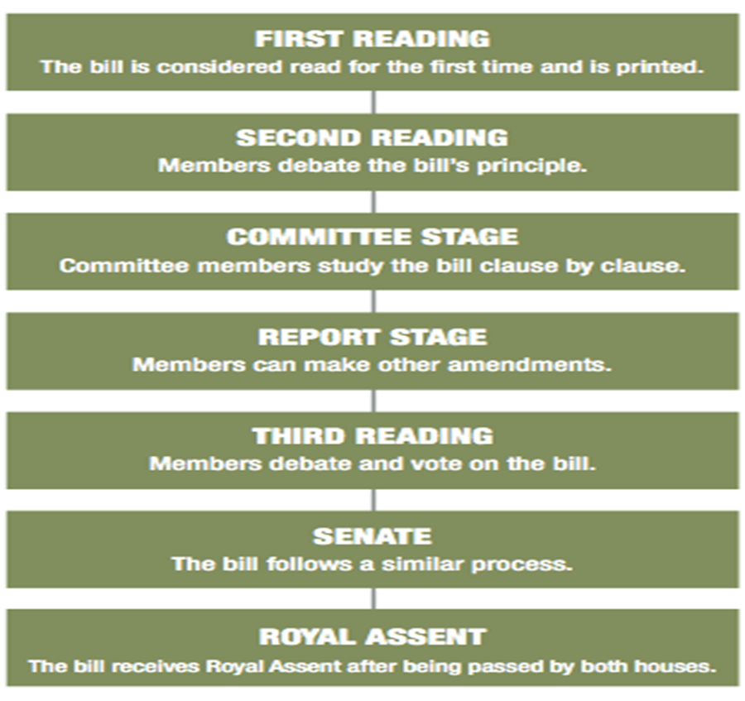
How a Bill Becomes a Law
Notes:
The AFN National Chief Appearance
Currently, the AFN is preparing for National Chief Cindy Woodhouse Nepinak’s
appearance in the fall, as well as a written brief and proposed amendments.
INAN will conclude their study of Bill C-61, which includes a clause-by-clause
review. The committee will proceed to the Report Stage where members may
propose motions to amend the text of the Bill.
At Third Reading, the House of Commons will debate the final form of the Bill and a
motion will be presented to adopt the Bill.
The Bill will then proceed to the Senate for consideration and passage. The Senate
follows a similar legislative process to the one in the House of Commons. The
Senate may make amendments to a Bill or adopt the Bill without amendment.
Royal Assent is the stage that a bill must pass before officially becoming an act of
Parliament. A bill will not be given Royal Assent unless it has gone through all the
stages of the legislative process and has been passed by both Houses in identical
form.

Slide 13
Process for Amendments
Stuart Wuttke
AFN Legal Counsel
Notes:
Currently, the AFN is preparing for National Chief Cindy Woodhouse Nepinak’s appearance in the fall, as well as a written brief and proposed amendments.
Rights-Holders Engagement
The AFN is preparing to gather responses from rights-holders.
Five Year Evaluations
Bill C-61 provides for five-year evaluations and the preparation of reports to Parliament on the effectiveness and impact of the First Nations Clean Water Act. The cumulative effect of the provisions of the proposed legislation could fundamentally change the legal and daily operational policy context for source water, drinking water and wastewater services. The review provisions will keep these matters within a national lens over time, allowing an ongoing assessment if systems are changing, including the view and input of First Nations leaders and communities as to whether these changes are adequate and sufficiently
comprehensive to make a dent in the legacy of failed federal policies.

Slide 14
Process for Amendments
The 2nd reading stage of the legislative process allows for debate on the general scope and principle of the bill.
At the Committee stage, invited witnesses may appear to present their views, request proposed amendments, and answer questions. Afterwards, the committee proceeds to clause-by-clause review of the bill and proposed amendments will be considered.
Once all the clauses of the bill have been considered and adopted, with or without amendments, the committee votes on the bill as a whole and refers the Bill back to the House.

Slide 15
Process for Submitting Brief and Preparing for an Appearance at Study Stage
Amanda Bruce - Acting Associate Director
Strategic Policy Integration

Slide 16
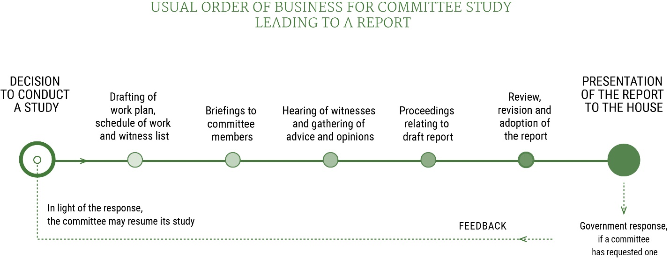
INAN Committee Study Phase
Source: Our Commons Website

Slide 17
How to Participate at the INAN Committee
Here are the profiles of the members of INAN:
https://www.ourcommons.ca/Committees/en/INAN/Members
Here is the process for requesting to make an appearance:
https://www.ourcommons.ca/Procedure/Guides/Witness-e.html
Here is the process for submitting briefs to the House of Commons Committees:
https://www.ourcommons.ca/Procedure/Guides/brief-e.html
INAN Contact: Cédric Taquet Clerk of the committee
Tel.: 613-996-1173 E-mail: INAN@parl.gc.ca
Website: ourcommons.ca/INAN-e

Slide 18
Preparing a Brief to Submit to the INAN Committee
Bill C-61 Study Link: https://www.ourcommons.ca/committees/en/INAN/StudyActivity?studyActivityId=12799569
General Format for a Brief: 12 pt font, 10 pages maximum
Note: Committees often develop specific requirements for individual studies—word counts (i.e. maximum 2,000 words) are often used in place of the 10-page limit
Committee Clerks will have information on briefs if this is not available on the website
Briefs are submitted via email to the Committee Clerk or through the Committee Portal
All briefs are translated prior to being posted on the Committee website
This process usually takes about 2 weeks
All briefs become public record

Slide 19
Preparing a Brief to Submit to the INAN Committee
General Structure of a Brief (This is flexible)
Cover page:
Include name of entity making submission, contact information
Summary:
Provide a brief overview of the submission (all briefs 10-pages in length should include summary)
Introduction:
Introduce topic and/or group/individual
Main Body:
Outline the group’s/individual’s position
Recommendations/Conclusion:
Provide recommendations or concluding remarks
About:
Provide the Committee with details about the group/individual submitting the brief

Slide 20
Preparing a Brief to Submit to the INAN Committee
Tips for Writing Effective Briefs
Create an outline to ensure your points are clear
Use plain language
Use point-first writing
Make your key statements at the start of paragraphs/sections
Use short and concise sentences
Use active-voice
Subject-verb-object

Slide 21
Preparing to Appear at the INAN Committee
Generally, witnesses appear in groups (with up to two witness per organization)
Each organization is provided with 5 minutes to provide opening remarks
Members of the Committee are then provided an allotted amount of time to ask questions of the witnesses
Some members will have specific questions for specific witnesses; others will ask broad questions of all witnesses
Often members will recycle questions from previous meetings
Committee Clerks will request that opening statements be submitted in advance
Witnesses who choose to appear virtually will be required to have specific headsets and conduct a technical test prior to their appearance

Slide 22
Questions
?

Slide 23
Conclusion
Thank You Merci
Notes:
In conclusion, Bill C-61 will require improvements at this point and into the future if it receives Royal Assent. As a priority, the AFN has identified for improvement in order to more closely align with the emergent policy positions of First Nations. Whether improvements can be achieved at this stage or can be deferred to further processes is uncertain at this time. It is recommended that suggested improvements be brought forward for to the Commons Standing Committee for consideration. Coordinated submissions by First Nations can outline areas for improvement and advocate for ongoing progress in water, source water, drinking water, wastewater and related infrastructure reforms.
The AFN might also consider recommending further internal technical work on the preparation of the Standing Committee’s resumption of hearings in the fall, as well as preparing for future Senate hearings. Such further technical work could be brought back for review and be directed at ensuring all First Nations governments can benefit from the changes Bill draft legislation C-61. This should include access resources and supports to ensure First Nations are appropriately served and supported.
Bill C-61 opens a pathway to First Nations legislative, regulatory, and administrative space and control for activities in relation to water, source water, drinking water, wastewater, and related infrastructure on First Nations lands. First Nations have the space to enact laws which will build and evolve over time through ongoing refinement of the principles in the First Nations Clean Water Act and through regulations. First Nations will have the opportunity to participate in parliamentary reviews of the First Nations Clean Water Act every five years. with reporting to the House of Commons on the effectiveness of the First Nations Clean Water Act and on necessary improvements identified at each juncture.

